Slide 1
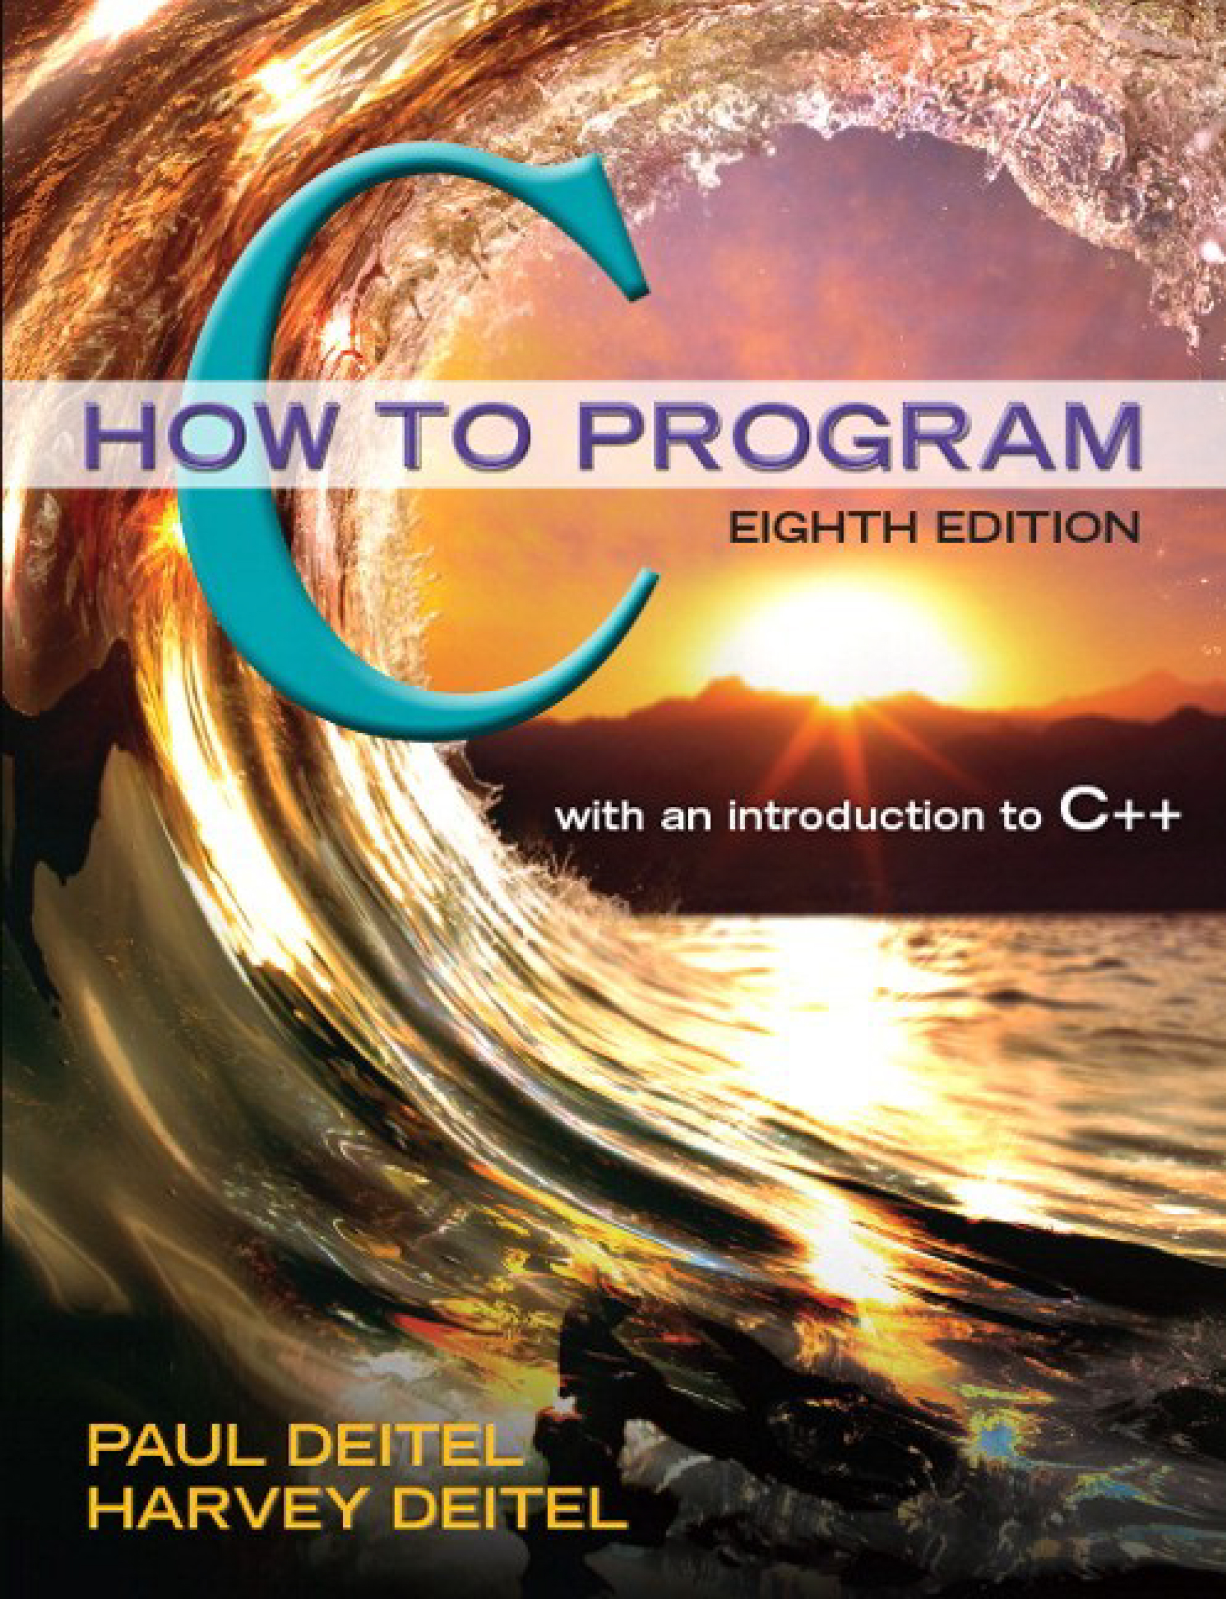
C How to Program
Eighth Edition
Chapter 2
Introduction to C Programming
Copyright © 2016, 2013, 2010 Pearson Education, Inc. All Rights Reserved
Notes:
If this PowerPoint presentation contains mathematical equations, you may need to check that your computer has the following installed:
1) MathType Plugin
2) Math Player (free versions available)
3) NVDA Reader (free versions available)

Slide 2
Learning Objectives
Write simple C programs.
Use simple input and output statements.
Use the fundamental data types.
Learn computer memory concepts.
Use arithmetic operators.
Learn the precedence of arithmetic operators.
Write simple decisionmaking statements.
Begin focusing on secure C programming practices.

Slide 3
Outline
2.1 Introduction
2.2 A Simple C Program: Printing a Line of Text
2.3 Another Simple C Program: Adding Two Integers
2.4 Memory Concepts
2.5 Arithmetic in C
2.6 Decision Making: Equality and Relational Operators
2.7 Secure C Programming

Slide 4
2.1 Introduction
The C language facilitates a structured and disciplined approach to computer program design.
In this chapter we introduce C programming and present several examples that illustrate many important features of C.
In Chapters 3 and 4 we present an introduction to structured programming in C.

Slide 5
2.2 A Simple C Program: Printing a Line of Text (1 of 17)
We begin by considering a simple C program.
Our first example prints a line of text (Figure 2.1).

Slide 6
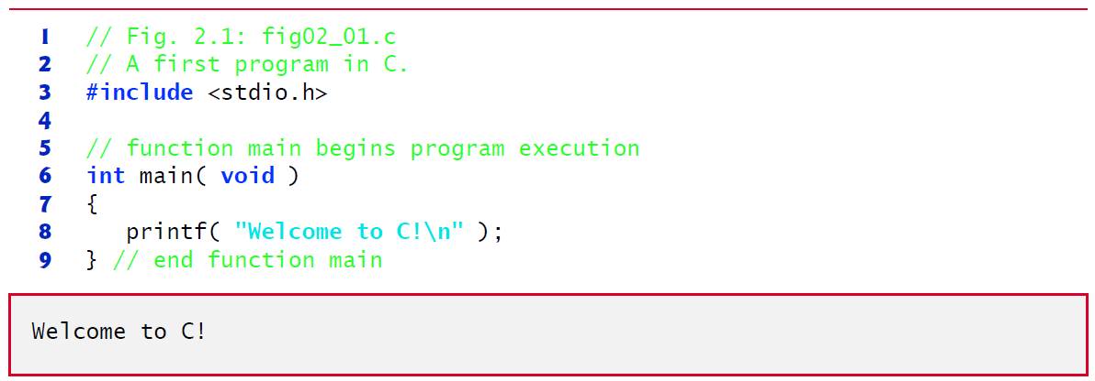
Figure 2.1 A First Program in C

Slide 7
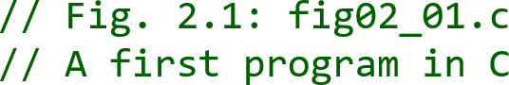
2.2 A Simple C Program: Printing a Line of Text (2 of 17)
begin with //, indicating that these two lines are comments.
Comments document programs and improve program readability.
Comments do not cause the computer to perform any action when the program is run.

Slide 8
2.2 A Simple C Program: Printing a Line of Text (3 of 17)
Comments are ignored by the C compiler and do not cause any machine-language object code to be generated.
Comments also help other people read and understand your program.

Slide 9
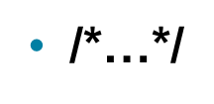
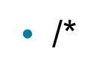


2.2 A Simple C Program: Printing a Line of Text (4 of 17)
multi-line comments in which everything from
You can also use
on the first line to
at the end of the line is a comment.
We prefer // comments because they’re shorter and they eliminate the common programming errors that occur with
comments, especially when the closing
is omitted.
#include Preprocessor Directive
is a directive to the C preprocessor.

Slide 10
2.2 A Simple C Program: Printing a Line of Text (5 of 17)
Lines beginning with # are processed by the preprocessor before compilation.
Line 3 tells the preprocessor to include the contents of the standard input/output header (<stdio.h>) in the program.
This header contains information used by the compiler when compiling calls to standard input/output library functions such as printf.
Blank Lines and White Space
You use blank lines, space characters and tab characters (i.e., “tabs”) to make programs easier to read.
Together, these characters are known as white space. White-space characters are normally ignored by the compiler.

Slide 11
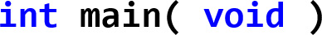
2.2 A Simple C Program: Printing a Line of Text (6 of 17)
The main Function
is a part of every C program.
The parentheses after main indicate that main is a program building block called a function.

Slide 12
2.2 A Simple C Program: Printing a Line of Text (7 of 17)
C programs contain one or more functions, one of which must be main.
Every program in C begins executing at the function main.
The keyword int to the left of main indicates that main “returns” an integer (whole number) value.
We’ll explain what it means for a function to “return a value” when we demonstrate how to create your own functions in Chapter 5.

Slide 13
2.2 A Simple C Program: Printing a Line of Text (8 of 17)
For now, simply include the keyword int to the left of main in each of your programs.
Functions also can receive information when they’re called upon to execute.
The void in parentheses here means that main does not receive any information.

Slide 14
Good Programming Practice 2.1
Every function should be preceded by a comment describing the function’s purpose.

Slide 15
2.2 A Simple C Program: Printing a Line of Text (9 of 17)
A left brace, {, begins the body of every function
A corresponding right brace ends each function
This pair of braces and the portion of the program between the braces is called a block.
An Output Statement
instructs the computer to perform an action, namely to print on the screen the string of characters marked by the quotation marks.
A string is sometimes called a character string, a message or a literal.

Slide 16
2.2 A Simple C Program: Printing a Line of Text (10 of 17)
The entire line, including the printf function (the “f” stands for “formatted”), its argument within the parentheses and the semicolon (;), is called a statement.
Every statement must end with a semicolon (also known as the statement terminator).
When the preceding printf statement is executed, it prints the message Welcome to C! on the screen.
The characters normally print exactly as they appear between the double quotes in the printf statement.
Escape Sequences
Notice that the characters \n were not printed on the screen.
The backslash (\) is called an escape character.
It indicates that printf is supposed to do something out of the ordinary.

Slide 17
2.2 A Simple C Program: Printing a Line of Text (11 of 17)
When encountering a backslash in a string, the compiler looks ahead at the next character and combines it with the backslash to form an escape sequence.
The escape sequence \n means newline.
When a newline appears in the string output by a printf, the newline causes the cursor to position to the beginning of the next line on the screen.
Some common escape sequences are listed in Figure 2.2.

Slide 18
Figure 2.2 Some Common Escape Sequences
Escape sequence | Description
\n | Newline. Position the cursor at the beginning of the next line.
\t | Horizontal tab. Move the cursor to the next tab stop.
\a | Alert. Produces a sound or visible alert without changing the current cursor position.
\\ | Backslash. Insert a backslash character in a string.
\” | Double quote. Insert a double-quote character in a string.

Slide 19
2.2 A Simple C Program: Printing a Line of Text (12 of 17)
Because the backslash has special meaning in a string, i.e., the compiler recognizes it as an escape character, we use a double backslash (\\) to place a single backslash in a string.
Printing a double quote also presents a problem because double quotes mark the boundaries of a string—such quotes are not printed.
By using the escape sequence \" in a string to be output by printf, we indicate that printf should display a double quote.
The right brace, }, indicates that the end of main has been reached.

Slide 20
Good Programming Practice 2.2
Add a comment to the line containing the right brace, }, that closes every function, including main.

Slide 21
2.2 A Simple C Program: Printing a Line of Text (13 of 17)
We said that printf causes the computer to perform an action.
As any program executes, it performs a variety of actions and makes decisions.
Chapter 3 discusses this action/decision model of programming in depth.

Slide 22
Common Programming Error 2.1
Mistyping the name of the output function printf as print in a program.

Slide 23
2.2 A Simple C Program: Printing a Line of Text (14 of 17)
The Linker and Executables
Standard library functions like printf and scanf are not part of the C programming language.
For example, the compiler cannot find a spelling error in printf or scanf.
When the compiler compiles a printf statement, it merely provides space in the object program for a “call” to the library function.
But the compiler does not know where the library functions are—the linker does.
When the linker runs, it locates the library functions and inserts the proper calls to these library functions in the object program.

Slide 24
2.2 A Simple C Program: Printing a Line of Text (15 of 17)
Now the object program is complete and ready to be executed.
For this reason, the linked program is called an executable.
If the function name is misspelled, it’s the linker that will spot the error, because it will not be able to match the name in the C program with the name of any known function in the libraries.

Slide 25
Good Programming Practice 2.3
Indent the entire body of each function one level of indentation (we recommend three spaces) within the braces that define the body of the function. This indentation emphasizes the functional structure of programs and helps make them easier to read.

Slide 26
Good Programming Practice 2.4
Set a convention for the indent size you prefer and then uniformly apply that convention. The tab key may be used to create indents, but tab stops can vary. Professional style guides often recommend using spaces rather than tabs.

Slide 27
2.2 A Simple C Program: Printing a Line of Text (16 of 17)
Using Multiple printfs
The printf function can print Welcome to C! several different ways.
For example, the program of Figure 2.3 produces the same output as the program of Figure 2.1 (see slide 6).
This works because each printf resumes printing where the previous printf stopped printing.
The first printf prints Welcome followed by a space and the second printf begins printing on the same line immediately following the space.

Slide 28
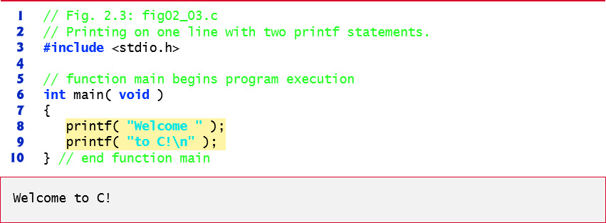
Figure 2.3 Printing One Line with Two Printf Statements

Slide 29
2.2 A Simple C Program: Printing a Line of Text (17 of 17)
One printf can print several lines by using additional newline characters as in Figure 2.4.
Each time the \n (newline) escape sequence is encountered, output continues at the beginning of the next line.

Slide 30
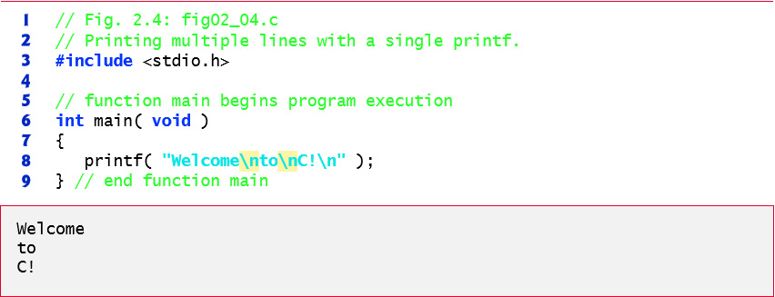
Figure 2.4 Printing Multiple Lines with a Single Printf

Slide 31
2.3 Another Simple C Program: Adding Two Integers (1 of 13)
Our next program (Figure 2.5) uses the Standard Library function scanf to obtain two integers typed by a user at the keyboard, computes the sum of these values and prints the result using printf.
[In the input/output dialog of Figure 2.5, we emphasize the numbers entered by the user in bold.]

Slide 32
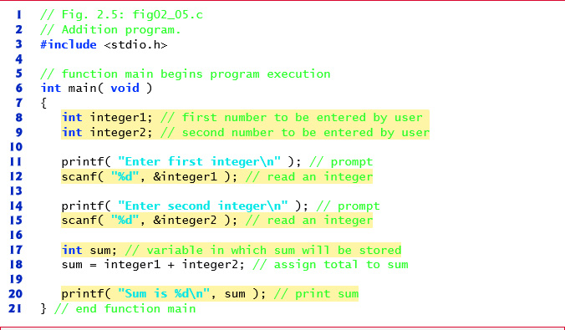
Figure 2.5 Addition Program (1 of 2)

Slide 33
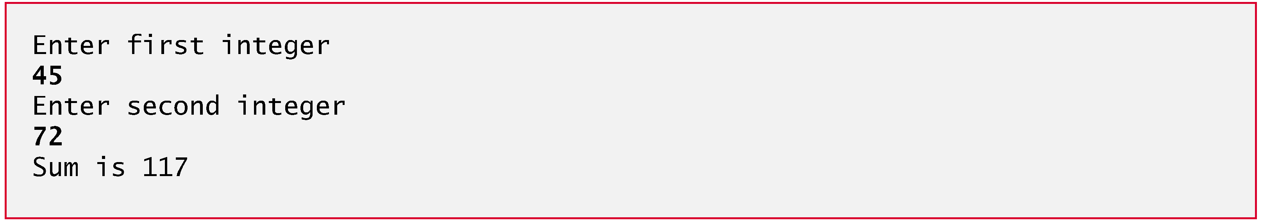
Figure 2.5 Addition Program (2 of 2)

Slide 34
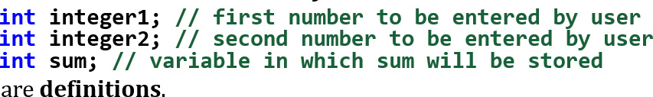
2.3 Another Simple C Program: Adding Two Integers (2 of 13)
Variables and Variable Definitions
The names integer1, integer2 and sum are the names of variables—locations in memory where values can be stored for use by a program.
These definitions specify that the variables integer1, integer2 and sum are of type int, which means that they’ll hold integer values, i.e., whole numbers such as 7, –11, 0, 31914 and the like.

Slide 35
2.3 Another Simple C Program: Adding Two Integers (3 of 13)
All variables must be defined with a name and a data type before they can be used in a program.
The preceding definitions could have been combined into a single definition statement as follows:
but that would have made it difficult to describe the variables with corresponding comments

Slide 36
2.3 Another Simple C Program: Adding Two Integers (4 of 13)
Identifiers and Case Sensitivity
A variable name in C is any valid identifier.
An identifier is a series of characters consisting of letters, digits and underscores (_) that does not begin with a digit.
C is case sensitive—uppercase and lowercase letters are different in C, so a1 and A1 are different identifiers.

Slide 37
Common Programming Error 2.2
Using a capital letter where a lowercase letter should be used (for example, typing Main instead of main).

Slide 38
Error-Prevention Tip 2.1
Avoid starting identifiers with the underscore character (_) to prevent conflicts with compiler-generated identifiers and standard library identifiers.

Slide 39
Good Programming Practice 2.5
Choosing meaningful variable names helps make a program self-documenting—that is, fewer comments are needed.

Slide 40
Good Programming Practice 2.6
The first letter of an identifier used as a simple variable name should be a lowercase letter. Later in the text we’ll assign special significance to identifiers that begin with a capital letter and to identifiers that use all capital letters.

Slide 41
Good Programming Practice 2.7
Multiple-word variable names can help make a program more readable. Separate the words with underscores as in total_commissions, or, if you run the words together, begin each word after the first with a capital letter as in totalCommissions. The latter style—often called camel casing because the pattern of uppercase and lowercase letters resembles the silhouette of a camel—is preferred.

Slide 42
2.3 Another Simple C Program: Adding Two Integers (5 of 13)
Prompting Messages
displays the literal “Enter first integer” and positions the cursor to the beginning of the next line.
This message is called a prompt because it tells the user to take a specific action.

Slide 43
2.3 Another Simple C Program: Adding Two Integers (6 of 13)
The scanf Function and Formatted Inputs
The next statement
uses scanf to obtain a value from the user.
The scanf function reads from the standard input, which is usually the keyboard.

Slide 44
2.3 Another Simple C Program: Adding Two Integers (7 of 13)
This scanf has two arguments, "%d" and &integer1.
The first, the format control string, indicates the type of data that should be input by the user.
The %d conversion specifier indicates that the data should be an integer (the letter d stands for “decimal integer”).
The % in this context is treated by scanf (and printf as we’ll see) as a special character that begins a conversion specifier.
The second argument of scanf begins with an ampersand (&)—called the address operator in C — followed by the variable name.

Slide 45
2.3 Another Simple C Program: Adding Two Integers (8 of 13)
The &, when combined with the variable name, tells scanf the location (or address) in memory at which the variable integer1 is stored.
The computer then stores the value that the user enters for integer1 at that location.
The use of ampersand (&) is often confusing to novice programmers or to people who have programmed in other languages that do not require this notation.
For now, just remember to precede each variable in every call to scanf with an ampersand.

Slide 46
Good Programming Practice 2.8
Place a space after each comma (,) to make programs more readable.

Slide 47
2.3 Another Simple C Program: Adding Two Integers (9 of 13)
When the computer executes the preceding scanf, it waits for the user to enter a value for variable integer1.
The user responds by typing an integer, then pressing the Enter key to send the number to the computer.
The computer then assigns this number, or value, to the variable integer1.
Any subsequent references to integer1 in this program will use this same value.
Functions printf and scanf facilitate interaction between the user and the computer.
Because this interaction resembles a dialogue, it’s often called interactive computing.

Slide 48
2.3 Another Simple C Program: Adding Two Integers (10 of 13)
displays the message Enter second integer on the screen, then positions the cursor to the beginning of the next line.
This printf also prompts the user to take action.
obtains a value for variable integer2 from the user.

Slide 49
2.3 Another Simple C Program: Adding Two Integers (11 of 13)
Assignment Statement
The assignment statement
calculates the total of variables integer1 and integer2 and assigns the result to variable sum using the assignment operator =.
The statement is read as, “sum gets the value of integer1 + integer2.” Most calculations are performed in assignments.
The = operator and the + operator are called binary operators because each has two operands.
The + operator’s two operands are integer1 and integer2.
The = operator’s two operands are sum and the value of the expression integer1 + integer2.

Slide 50
Good Programming Practice 2.9
Place spaces on either side of a binary operator. This makes the operator stand out and makes the program more readable.

Slide 51
Common Programming Error 2.3
A calculation in an assignment statement must be on the right side of the = operator. It’s a compilation error to place a calculation on the left side of an assignment operator.

Slide 52
2.3 Another Simple C Program: Adding Two Integers (12 of 13)
Printing with a Format Control String
calls function printf to print the literal Sum is followed by the numerical value of variable sum on the screen.
This printf has two arguments, "Sum is %d\n" and sum.
The first argument is the format control string.
It contains some literal characters to be displayed, and it contains the conversion specifier %d indicating that an integer will be printed.
The second argument specifies the value to be printed.
Notice that the conversion specifier for an integer is the same in both printf and scanf.

Slide 53
2.3 Another Simple C Program: Adding Two Integers (13 of 13)
Calculations in printf Statements
We could have combined the previous two statements into the statement
The right brace, }, at line 21 indicates that the end of function main has been reached.

Slide 54
Common Programming Error 2.4
Forgetting to precede a variable in a scanf statement with an ampersand (&) when that variable should, in fact, be preceded by an ampersand results in an execution-time error. On many systems, this causes a “segmentation fault” or “access violation.” Such an error occurs when a user’s program attempts to access a part of the computer’s memory to which it does not have access privileges. The precise cause of this error will be explained in Chapter 7.

Slide 55
Common Programming Error 2.5
Preceding a variable included in a printf statement with an ampersand when, in fact, that variable should not be preceded by an ampersand.

Slide 56
2.4 Memory Concepts (1 of 5)
Variable names such as integer1, integer2 and sum actually correspond to locations in the computer’s memory.
Every variable has a name, a type and a value.
In the addition program of Figure 2.5 (see slide 32-33), when the statement
is executed, the value entered by the user is placed into a memory location to which the name integer1 has been assigned.
Suppose the user enters the number 45 as the value for integer1.
The computer will place 45 into location integer1 as shown in Figure 2.6.

Slide 57
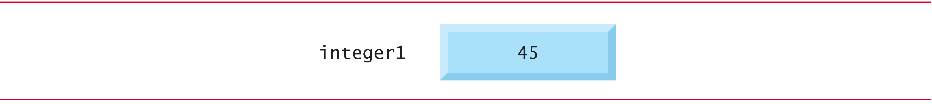
Figure 2.6 Memory Location Showing the Name and Value of a Variable

Slide 58
2.4 Memory Concepts (2 of 5)
Whenever a value is placed in a memory location, the value replaces the previous value in that location; thus, this process is said to be destructive.
When the statement
executes, suppose the user enters the value 72.
This value is placed into location integer2, and memory appears as in Figure 2.7.
These locations are not necessarily adjacent in memory.

Slide 59
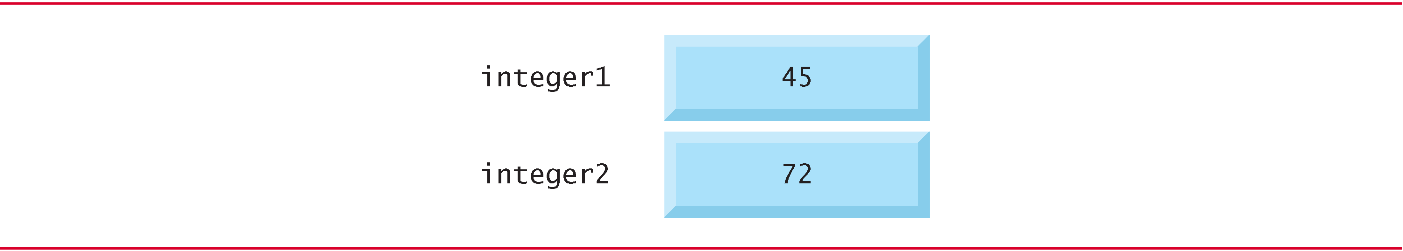
Figure 2.7 Memory Locations After Both Variables Are Input

Slide 60
2.4 Memory Concepts (3 of 5)
Once the program has obtained values for integer1 and integer2, it adds these values and places the total into variable sum.
replaces whatever value was stored in sum.

Slide 61
2.4 Memory Concepts (4 of 5)
This occurs when the calculated total of integer1 and integer2 is placed into location sum (destroying the value already in sum).
After sum is calculated, memory appears as in Figure 2.8.
The values of integer1 and integer2 appear exactly as they did before they were used in the calculation.

Slide 62
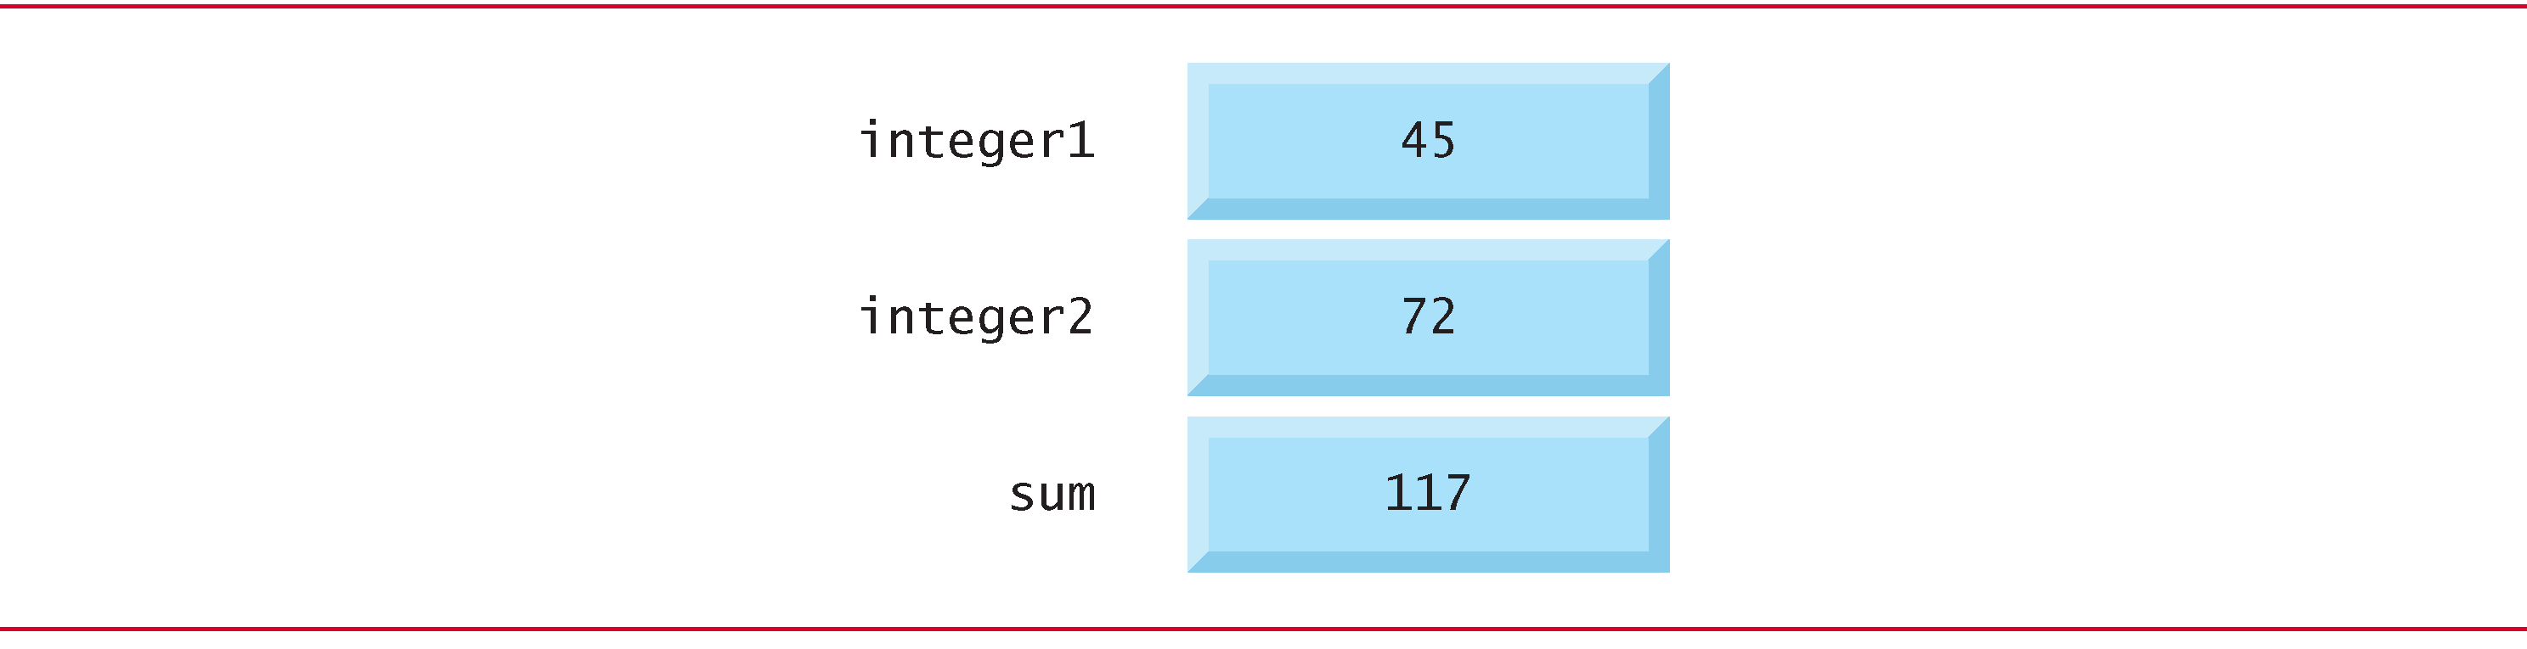
Figure 2.8 Memory Locations After a Calculation

Slide 63
2.4 Memory Concepts (5 of 5)
They were used, but not destroyed, as the computer performed the calculation.
Thus, when a value is read from a memory location, the process is said to be nondestructive.

Slide 64
2.5 Arithmetic in C (1 of 9)
Most C programs perform calculations using the C arithmetic operators (Figure 2.9).
The asterisk (*) indicates multiplication and the percent sign (%) denotes the remainder operator, which is introduced below.
In algebra, to multiply a times b, we simply place these single-letter variable names side by side as in ab.
In C, however, if we were to do this, ab would be interpreted as a single, two-letter name (or identifier).
Therefore, C requires that multiplication be explicitly denoted by using the * operator as in a * b.
The arithmetic operators are all binary operators.
For example, the expression 3 + 7 contains the binary operator + and the operands 3 and 7.

Slide 65
Figure 2.9 Arithmetic Operators
C operation | Arithmetic operator | Algebraic expression | C expression
Addition | + | f + 7 | f + 7
Subtraction | – | p – c | p − c
Multiplication | * | bm | b * m
Division | / | X slash y or x over y or x divided by y. | start fraction x over y end fraction
Remainder | % | r mod s | r % s

Slide 66
2.5 Arithmetic in C (2 of 9)
Integer Division and the Remainder Operator
Integer division yields an integer result
For example, the expression
evaluates to 1 and the
C provides the remainder operator, %, which yields the remainder after integer division
Can be used only with integer operands
The expression x % y yields the remainder after x is divided by y
Thus, 7 % 4 yields 3 and 17 % 5 yields 2

Slide 67
Common Programming Error 2.6
An attempt to divide by zero is normally undefined on computer systems and generally results in a fatal error that causes the program to terminate immediately without having successfully performed its job. Nonfatal errors allow programs to run to completion, often producing incorrect results.

Slide 68
2.5 Arithmetic in C (3 of 9)
Arithmetic Expressions in Straight-Line Form
Arithmetic expressions in C must be written in straight-line form to facilitate entering programs into the computer.
Thus, expressions such as “a divided by b” must be written as a/b so that all operators and operands appear in a straight line.
The algebraic notation
is generally not acceptable to compilers, although some special-purpose software packages do support more natural notation for complex mathematical expressions.

Slide 69
2.5 Arithmetic in C (4 of 9)
Parentheses for Grouping Subexpressions
Parentheses are used in C expressions in the same manner as in algebraic expressions.
For example, to multiply a times the quantity b + c we write

Slide 70
2.5 Arithmetic in C (5 of 9)
Rules of Operator Precedence
C applies the operators in arithmetic expressions in a precise sequence determined by the following rules of operator precedence, which are generally the same as those in algebra:
Operators in expressions contained within pairs of parentheses are evaluated first. Parentheses are said to be at the “highest level of precedence.” In cases of nested, or embedded, parentheses, such as
the operators in the innermost pair of parentheses are applied first.

Slide 71
2.5 Arithmetic in C (6 of 9)
Multiplication, division and remainder operations are applied next. If an expression contains several multiplication, division and remainder operations, evaluation proceeds from left to right. Multiplication, division and remainder are said to be on the same level of precedence.
Addition and subtraction operations are evaluated next. If an expression contains several addition and subtraction operations, evaluation proceeds from left to right. Addition and subtraction also have the same level of precedence, which is lower than the precedence of the multiplication, division and remainder operations.
The assignment operator (=) is evaluated last.

Slide 72
2.5 Arithmetic in C (7 of 9)
The rules of operator precedence specify the order C uses to evaluate expressions. When we say evaluation proceeds from left to right, we’re referring to the associativity of the operators.
We’ll see that some operators associate from right to left.
Figure 2.10 summarizes these rules of operator precedence for the operators we’ve seen so far.

Slide 73
Figure 2.10 Precedence of Arithmetic Operators
Operator(s) | Operation(s) | Order of evaluation (precedence)
( ) | Parentheses | Evaluated first. If the parentheses are nested, the expression in the innermost pair is evaluated first. If there are several pairs of parentheses “on the same level” (i.e., not nested), they’re evaluated left to right.
* / % | Multiplication Division Remainder | Evaluated second. If there are several, they’re evaluated left to right.
+ − | Addition Subtraction | Evaluated third. If there are several, they’re evaluated left to right.
= | Assignment | Evaluated last.

Slide 74
2.5 Arithmetic in C (8 of 9)
Figure 2.11 illustrates the order in which the operators are applied.

Slide 75
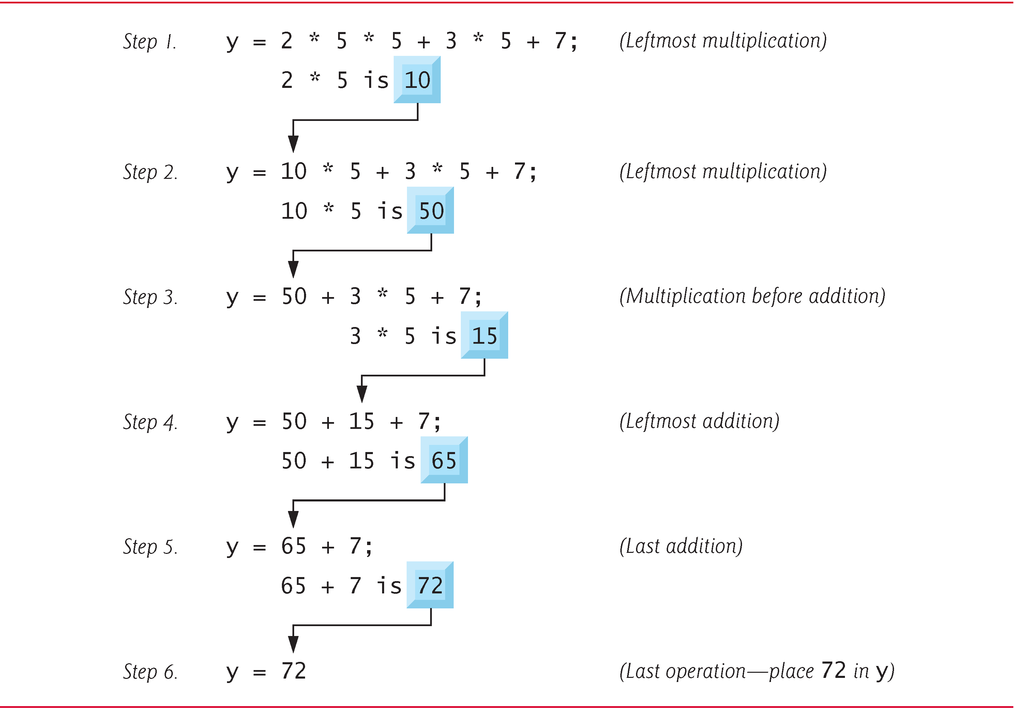
Figure 2.11 Order in Which a Second-Degree Polynomial is Evaluated

Slide 76
2.5 Arithmetic in C (9 of 9)
As in algebra, it’s acceptable to place unnecessary parentheses in an expression to make the expression clearer.
These are called redundant parentheses.

Slide 77
2.6 Decision Making: Equality and Relational Operators (1 of 9)
Executable C statements either perform actions (such as calculations or input or output of data) or make decisions (we’ll soon see several examples of these).
We might make a decision in a program, for example, to determine whether a person’s grade on an exam is greater than or equal to 60 and whether the program should print the message “Congratulations! You passed.”
This section introduces a simple version of C’s if statement that allows a program to make a decision based on the truth or falsity of a statement of fact called a condition.

Slide 78
2.6 Decision Making: Equality and Relational Operators (2 of 9)
If the condition is true (i.e., the condition is met) the statement in the body of the if statement is executed.
If the condition is false (i.e., the condition isn’t met) the body statement is not executed.
Whether the body statement is executed or not, after the if statement completes, execution proceeds with the next statement after the if statement.
Conditions in if statements are formed by using the equality operators and relational operators summarized in Figure 2.12.

Slide 79
2.6 Decision Making: Equality and Relational Operators (3 of 9)
The relational operators all have the same level of precedence and they associate left to right.
The equality operators have a lower level of precedence than the relational operators and they also associate left to right.
In C, a condition may actually be any expression that generates a zero (false) or nonzero (true) value.

Slide 80
Common Programming Error 2.7
A syntax error occurs if the two symbols in any of the operators
are separated by spaces.

Slide 81
Common Programming Error 2.8
Confusing the equality operator
with the assignment operator. To avoid this confusion, the equality operator should be read “double equals” and the assignment operator should be read “gets” or “is assigned the value of.” As you’ll see, confusing these operators may not cause an easy-to-recognize compilation error, but may cause extremely subtle logic errors.

Slide 82
Figure 2.12 Equality and Relational Operators (1 of 2)
Relational operators
Algebraic equality or relational operator | C equality or relational operator | Example of C condition | Meaning of C condition
> | > | x > y | x is greater than y
< | < | x < y | x is less than y
Greater than equals | >= | x >= y | x is greater than or equal to y
Less than equals | <= | x <= y | x is less than or equal to y

Slide 83
Figure 2.12 Equality and Relational Operators (2 of 2)
Equality operators
Algebraic equality or relational operator | C equality or relational operator | Example of C condition | Meaning of C condition
= | Equals equals | X equals equals y | x is equal to y
Not equals | exclamation mark equals | x exclamation mark equals y | x is not equal to y

Slide 84
2.6 Decision Making: Equality and Relational Operators (4 of 9)
Figure 2.13 uses six if statements to compare two numbers entered by the user.
If the condition in any of these if statements is true, the printf statement associated with that if executes.

Slide 85
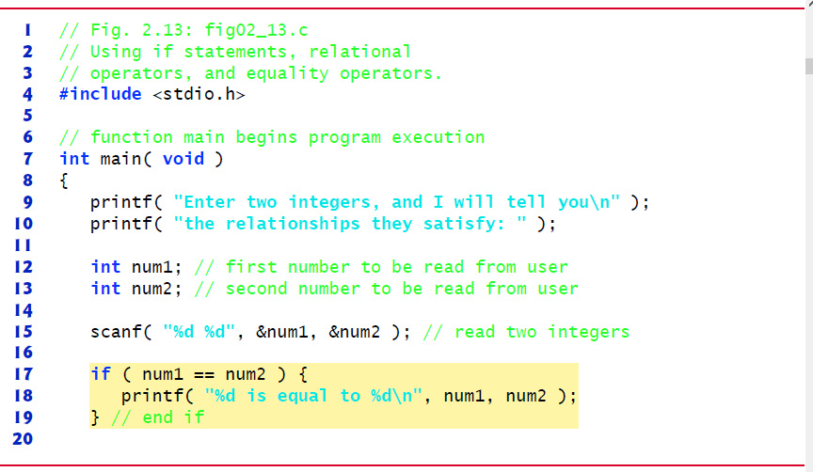
Figure 2.13 Using If Statements, Relational Operators, and Equality Operators (1 of 3)

Slide 86
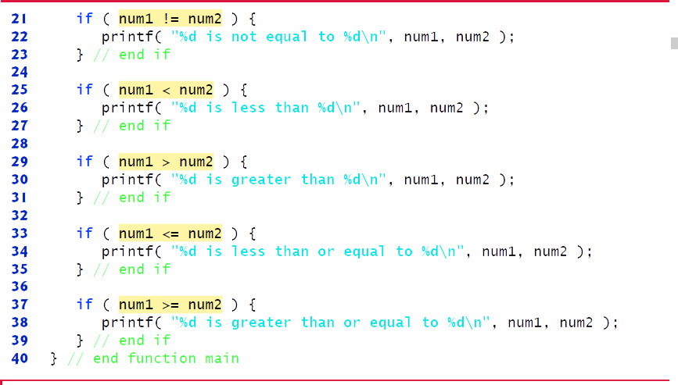
Figure 2.13 Using If Statements, Relational Operators, and Equality Operators (2 of 3)

Slide 87
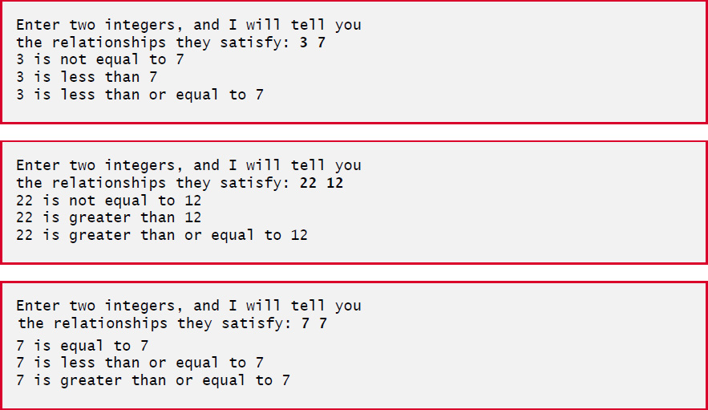
Figure 2.13 Using If Statements, Relational Operators, and Equality Operators (3 of 3)

Slide 88
2.6 Decision Making: Equality and Relational Operators (5 of 9)
The program uses scanf to input two numbers.
Each conversion specifier has a corresponding argument in which a value will be stored.
The first %d converts a value to be stored in the variable num1, and the second %d converts a value to be stored in variable num2.

Slide 89
Good Programming Practice 2.10
Although it’s allowed, there should be no more than one statement per line in a program.

Slide 90
Common Programming Error 2.9
Placing commas (when none are needed) between conversion specifiers in the format control string of a scanf statement.

Slide 91
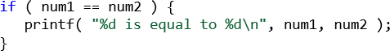
2.6 Decision Making: Equality and Relational Operators (6 of 9)
Comparing Numbers
The if statement
compares the values of variables num1 and num2 to test for equality.
If the conditions are true in one or more of the if statements, the corresponding body statement displays an appropriate line of text.
Indenting the body of each if statement and placing blank lines above and below each if statement enhances program readability.

Slide 92
Common Programming Error 2.10
Placing a semicolon immediately to the right of the right parenthesis after the condition in an if statement.

Slide 93
2.6 Decision Making: Equality and Relational Operators (7 of 9)
A left brace, {, begins the body of each if statement
A corresponding right brace, }, ends each if statement’s body
Any number of statements can be placed in the body of an if statement.

Slide 94
Good Programming Practice 2.11
A lengthy statement may be spread over several lines. If a statement must be split across lines, choose breaking points that make sense (such as after a comma in a comma-separated list). If a statement is split across two or more lines, indent all subsequent lines. It’s not correct to split identifiers.

Slide 95
2.6 Decision Making: Equality and Relational Operators (8 of 9)
Figure 2.14 (see slide 97) lists from highest to lowest the precedence of the operators introduced in this chapter.
Operators are shown top to bottom in decreasing order of precedence.
The equals sign is also an operator.
All these operators, with the exception of the assignment operator =, associate from left to right.
The assignment operator (=) associates from right to left.

Slide 96
Good Programming Practice 2.12
Refer to the operator precedence chart when writing expressions containing many operators. Confirm that the operators in the expression are applied in the proper order. If you’re uncertain about the order of evaluation in a complex expression, use parentheses to group expressions or break the statement into several simpler statements. Be sure to observe that some of C’s operators such as the assignment operator (=) associate from right to left rather than from left to right.

Slide 97
Figure 2.14 Precedence and Associativity of the Operators Discussed So Far
Operators | Associativity
() | left to right
* / % | left to right
+ − | left to right
< <= > >= | left to right
equals equals exclamation mark equals | left to right
= | right to left

Slide 98
2.6 Decision Making: Equality and Relational Operators (9 of 9)
Some of the words we’ve used in the C programs in this chapter—in particular int and if—are keywords or reserved words of the language.
Figure 2.15 contains the C keywords.
These words have special meaning to the C compiler, so you must be careful not to use these as identifiers such as variable names.

Slide 99
Figure 2.15 C’s Keywords
Keywords
auto | do | goto | signed | unsigned
break | double | if | sizeof | void
case | else | int | static | volatile
Char | enum | long | struct | while
const | extern | register | switch | Blank
continue | float | return | typedef | Blank
default | for | short | union | Blank
Keywords added in C99 standard
_Bool _Complex _Imaginary inline restrict
Keywords added in C11 standard
_Alignas _Alignof _Atomic _Generic _Noreturn _Static_assert _Thread_local

Slide 100
2.7 Secure C Programming (1 of 2)
C E R T C Secure Coding Standard
Guidelines that help you avoid programming practices that open systems to attacks
Avoid Single-Argument printfs
If you need to display a string that terminates with a newline, use the puts function, which displays its string argument followed by a newline character
For example
printf( "Welcome to C!\n" );
should be written as:
puts( "Welcome to C!" );
We did not include \n in the preceding string because puts adds it automatically.

Slide 101
2.7 Secure C Programming (2 of 2)
If you need to display a string without a terminating newline character, use printf with two arguments.
For example
printf( "Welcome " );
should be written as:
printf( "%s", "Welcome " );
These changes are responsible coding practices that eliminate certain security C vulnerabilities as we get deeper into C

Slide 102

Copyright

